Slide 1
Six Values for Discipleship in the Local Church
March 2 - Afternoon

Slide 2
Worship
Equipping
Evangelism
Global Missions
Compassion & Justice
Vocation
Common Good

Slide 3
Aiming at Discipleship
“If you make disciples, you always get the church. But if you make a Church, you rarely get disciples.”
(Breen and Cockram, Building a Discipling Culture, 2009)

Slide 4
What is Spiritual Maturity?
Knowing Jesus
Grasped by the Word of God
In Step with the Spirit
Godly Character
Equipped for Ministry

Slide 5
What is a Disciple?
“A disciple is one who responds in faith and obedience to the gracious call to follow Jesus. Being a disciple is a lifelong process of dying to self while allowing Jesus Christ to come alive in us.” (Greg Ogden, Discipleship Essentials, 24)

Slide 6
What is a Disciple?
“A disciple is someone who is following Jesus, being changed by Jesus, and committed to Jesus’ kingdom mission” (Bobby Harrington and Alex Absalom, Discipleship That Fits, 16 )

Slide 7
Mission of the Church
“Making whole-life missionary disciples is the core vocation of the church.” (Neil Hudson, 38)

Slide 8
Where Does Maturing Occur?
Regular Means of Grace – Worship
Sacraments – Small Groups
Retreats – Serving - Missions

Slide 9
Preaching
What Part Does Preaching Play in Discipleship?
A Lot
Some
A Little

Slide 10
Large Group – Catechesis?
A class – Bible Study Fellowship/CBS
Alpha Course
Bethel Bible Series
Summer Camp

Slide 11
Small Groups – Missional Communities?
Small Groups Can Do Discipleship
But They Can Pool Ignorance
Key is the Training of the Leaders.
Challenge is the Time for Training and Leading

Slide 12
Micro-Expressions – 1/3, 1/2 and 1/1

Slide 13
Selection - FIT
Faithful
Intentional
Teachable
Older-Younger
Potential Leaders – carrying this one after I am gone
Chemistry

Slide 14
6 Key Values of Discipleship
Intimate Relational Investment – alongside, life on life with them (Mark 3:14), Person over Program
Learning to Listen to the Holy Spirit Speak in Scripture
Developing Spiritual Practices and Habits
Expecting Transformation
Aiming at Multiplication – Creating Disciple-Makers
Lifetime Learners/Disciples

Slide 15
Value #1 – Intimate Relationships
“He appointed twelve that they might be with him and that he might send them out to preach.” (Mark 3:14)
“I no longer call you servants, because servants do not know their master’s business. Instead, I have called you friends, for everything I have learned from my Father I have made known to you.” (John 15:15)

Slide 16
Harrington - Discipleship
“An intentional process of investing in a life-on-life relationship where the person of Jesus Christ and the values of the Kingdom of God are being formed to be reproduced in another life.”

Slide 17
Why This Relational Value?
Accountability – someone is checking on you
Grace Filled to Counter Shame
Modeling – sharing their own life
Vulnerability – sharing struggles as well
Authenticity – ideal versus the real
Mutuality – building each other, Iron Sharpens Iron

Slide 18
Theological Fit?
Incarnational Model
Trinitarian Model
Covenantal Model

Slide 19
The Ask
1) Life on Life (maybe 2-3)
2) 15 minutes a day
3) 1 hour together a week
4) Extra times together
5) 11 months
6) Disciple someone next year

Slide 20
The Challenge
“The most difficult facet of this is setting aside the time it requires to make disciples.”
(Harrington and Patrick, 33)

Slide 21
Value #2 – Learning to Listen to the Holy Spirit in Scripture
What does it say? (What is this about?)
What does it mean (for all Christians)?
What is the Holy Spirit saying to me?

Slide 22
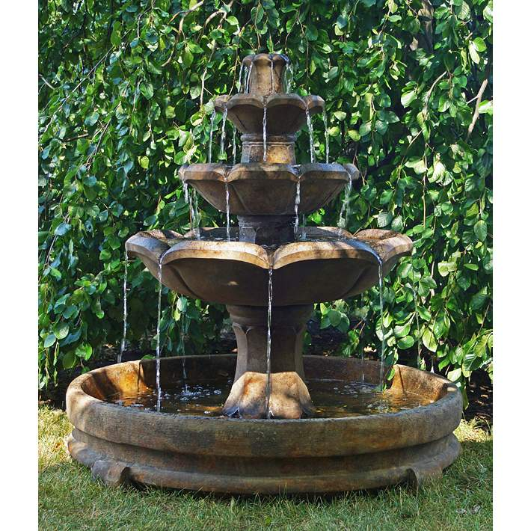
4 Layers of the Fountain
Identity
Values
Attitudes
Behavior

Slide 23
What Am I Asking?
10-15 Minutes a Day (don’t ask for an hour)
Writing in a Notebook
Let the Hunger Grow

Slide 24
Scope of Scripture
Gospel of Mark – a third of a chapter
Philippians
Ephesians
Psalms
John
Genesis
Acts

Slide 25
Proposed Schedule
September-October – Mark
November – Philippians and Ephesians
December –Psalms
January – March – John
April – Genesis
May – June - Acts

Slide 26
Dividing Mark 1
Mark 1:1-8
Mark 1:9-20
Mark 1:21-44

Slide 27
Mark 1 – Sample Study
Log In – How was the week?
Mark 1
a) John the Baptist – make straight paths for him
b) Baptism – beloved Son, with you I am well pleased
c) Wilderness – connected to beloved
d) Good News – Repent and Believe the Good News
e) Calling – Fishing for People

Slide 28
Mark
Week 1 – Mark 1-2
Week 2 – Mark 3-4
Week 3 – Mark 5-6
Week 4 – Mark 7-8 (What Do You See?)
Week 5 – Mark 9-10
Week 6 – Mark 11-12
Week 7 – Mark 13-14
Week 8 – Mark 15-16

Slide 29
Sample Study
Philippians 1: 1-11
Philippians 1:12-26
Philippians 1:27-30

Slide 30
Developing a Feedback Loop
Something about reading needs to bring a satisfaction to build the habit to continue.

Slide 31
Value #3 – Spiritual Practices
Space for God – Quiet Time, Devotional Time
Habits Take 6 weeks to 6 months
Sabbath
Prayer – how to pray and what to pray about
Discernment
Worship
Community
Serving

Slide 32
Reflection on Practices
Someone to Ask You to Reflect on Impact.
Attentiveness is the Key

Slide 33
Value #4 – Expect Transformation
What will change?
Commitment to Jesus
Competence with the Word and Practices
Character
Community
Fruitfulness – (Galatians 5:22-25)
Springs of Living Water – (John 4:14)
Filled to Fullness – (Ephesians 3:14-21)

Slide 34
How Much Transformation?

Slide 35
Starting Points and Growth
Pre-Sanctified
Characters are Variable
Growth is Uneven
Suffering Seems to Play a Catalytic Role
An Invested Discipler Also Plays a Role

Slide 36
Stay the Center Course
Between Galatians and I Corinthians
Between Religion and Irreligion
Between Law and License

Slide 37
Transformation
Identity (Yours)– Beloved Child of God – Crying Abba
Identity (God’s) – “If you have seen me you have seen the Father” (John 15)
Values – Kingdom Values Emerge (Thief)
God Pleasing – People Pleasing

Slide 38
Transformation
Attitudes – joy, patience, contentment, grace
Behavior – triggered by Identity, Values, and attitude

Slide 39
Deep Wounds addressed
Identity – Stupid, Worthless, Lazy, Ugly
Values Received
Self-Reliance – vs Trusting Community

Slide 40
Colossians 3:12-17
Put Off and Put On
Old Wounds
New Identity

Slide 41
Theological Review
You were made in the Image of God
That Image was Distorted as the Fall
That Image Has Been Redeemed in Christ
That image is Being Restored in Christ

Slide 42
Value #5 - Multiplication
Making Disciples to be Disciple-Makers
Instill this vision from the beginning
Teach toward it – “next year when you are . . .”

Slide 43
Readiness Evaluations for Discipleship
More Than a Year
Paired with You
Launching When Barely Ready

Slide 44
Value #6 – Lifetime Learners
Keep Finding People to Invest in You
Keep Learning and Growing
Keep Seeking Others

Slide 45
Where to Focus?
Data of the Faith – Scripture
Grand Narrative – What is God Doing?
Spiritual Practices and Dynamics
Healing from Old Wounds
Specific Help for Mission – Callings
Re-Framing Life inside the Kingdom

Slide 46
Areas Touched
Head – Grand Narrative and Learning
Scripture and the Story
Heart – Restoring Intimacy with God
Will – “I have decided to follow Jesus.”
Character and Calling and Life

Slide 47
How We Change
1) Rational (Head) - Renewing the Mind
Romans 5-8 – Justification
Titus 3 – Born Anew - Regeneration
Ephesians 2:8-9 – Saved by Grace
John 14 – A Place Prepared
Galatians 4:4-7 – Abba Father
Mark 1 – Beloved Child
Philippians 3 – Knowing God

Slide 48
How Do We Change?
Rational (Head) – Renewing the Mind
Aware of the Invasion of the Holy Spirit
Aiming at Sanctification – Hebrews 4:12
Reclothed in New Clothes – Genesis 3
Observe Christian Behavior
Focus on a Christ-like Character
Life in the Kingdom of God

Slide 49
How Are We Restored?
Emotions (Heart) - Relationships
12 Disciples
Romans 16
Body of Christ Image
Someone with Skin On
Small Groups
Marriage
Church – Community of Believers

Slide 50
How We Are Restored?
Emotions
Restoration of Trust – God is Good
Satisfaction in Christ
Redefining a Brother/Sister
Anger Issues
Lust Issues
Greed Issues

Slide 51
How are We Restored?
Decisions (The Will) – Following Jesus
Choosing Character
Doing Evangelism
Supporting Global Missions
Engaging in Compassion - Justice
Standing for the Common Good
Living Intentionally in Vocation
Agreeing to Live with Influence

Slide 52
How Are We Restored
Spiritual Practices
Sabbath
Worship - Corporate
Confession – Pardon
Healing Prayers
Praise – Un-selfing Us
Eucharist (The Good Caress)

Slide 53
How Are We Restored?
Scripture
Read
Meditated Upon
Memorized
Seeing Grand Narrative

Slide 54
How Are We Restored?
Spiritual Practices
Prayer – Individual and Corporate
Knowing the Father
Expressing Desire
Offering the Self

Slide 55
How Are We Restored?
Healing – Restoration from Old Wounds
Sin Wounds
Shame and Hiddenness Wounds
Gender Wounds
Identity Wounds

Slide 56
How Are We Restored?
Healing – Demonic Activity
Occult Issues
Witch Doctor Curses/Spells
Splitter/Accuser Issues

Slide 57
Getting Started
Not Getting from 100s to 1000s
But Getting from 0-1
(Pay Pal – Peter Thiel)

Slide 58
Discipleship Troubles
When the Pastor Has Been Diverted From Discipleship
When Most Pastors Have Never Been Discipled
Attempts to Use Programs Over People
Focus on Eternal Benefit Over Changed Life
Discipleship as Extra Credit for the Few
Most Congregations Have No Clear Pathway to Maturity

